Slide 2
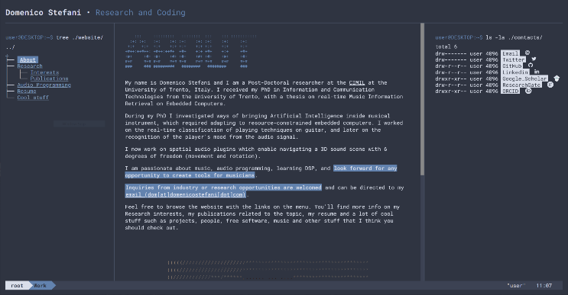
About Me
Ph.D. on Deep Learning inference for Real-time Audio in Plugins & Embedded
Currently: Post Doc with the CIMIL group, University of Trento, Italy
domenicostefani.com

Slide 3
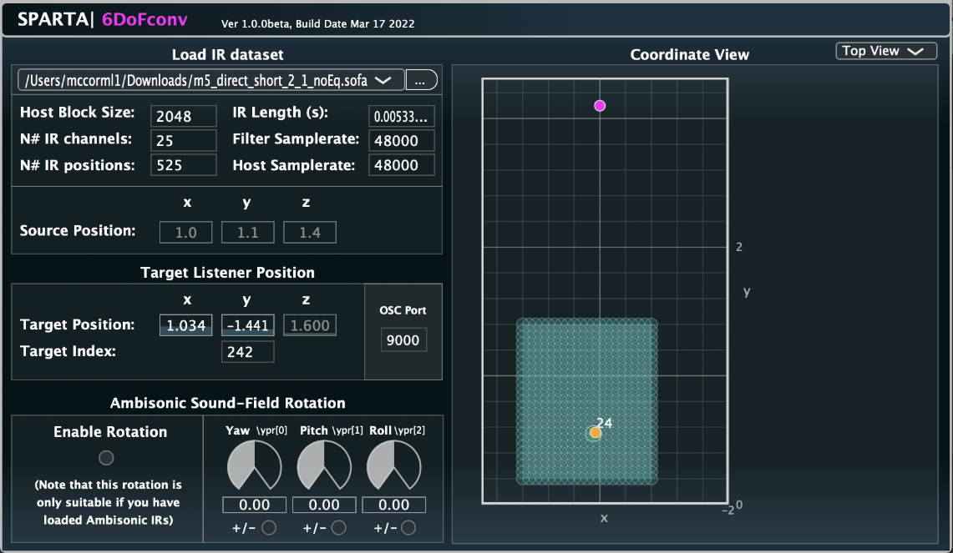
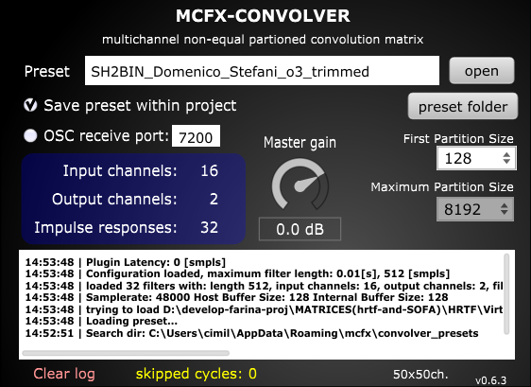
Project
Efficient Convolutions
3DoF Navigation, IR Matrix Crossfade, OSC

Slide 4
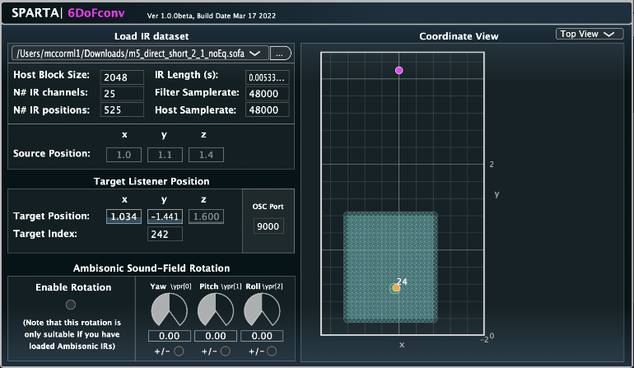
Engine Swap

Slide 5
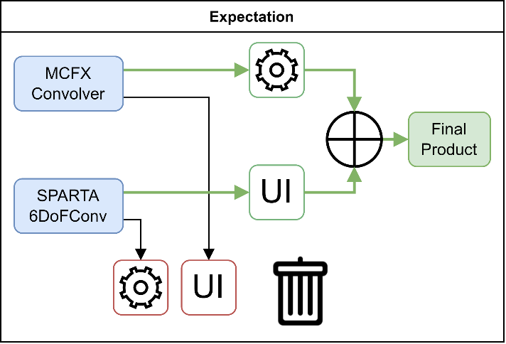
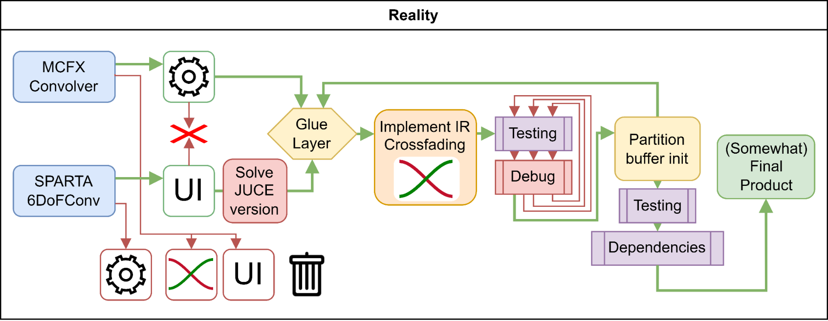
Expectation
vs Reality

Slide 6
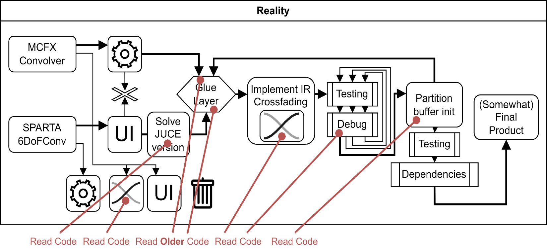
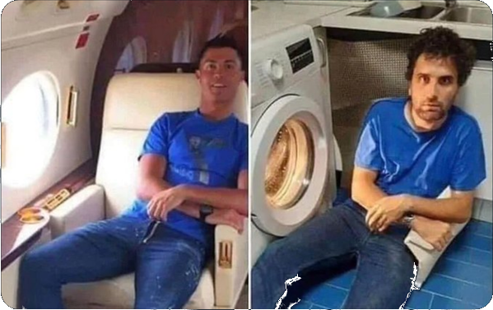
Real Real Reality

Slide 7
Understanding engine differences
From talking with researchers, reading documentation, reading the code:
MCFX Convolver
1 NxM IR Matrix
Reads WAVs
Non Uniform Partitioned Conv.
No Matrix Swap
SPARTA 6DoFConv
K, 1xN IR matrices
Reads SOFA files
Uniform Partitioned Convolution
Matrix Swap
✅
❌
❌
✅

Slide 8
First Issues
From reading the code:
MCFX Convolver
Not meant to change IR-matrix without stopping audio callback.
Allocates on matrix change.
Handles many threaded convolvers processing different partition lengths
SPARTA 6DoFConv
Matrix swap ?
1-buffer delay for position change
Crossfade ?
1 block crossfade, deeply embedded within old engine
Convolution and swap are integrated

Slide 9
Steps
Kills RAM
WORKS!
Efficient Multiposition
2 convolvers
For matrix change
Stops working
1st Integration
1 position
1 IR Matrix
Revert changes
Rethink life choices
It’s the stupid rotator
?
JUCE incompatibility
CMAKE issues
Dependencies
Need for equivalent WAV & SOFA matrices
Inefficient Multiposition
1 convolver per position
I wanted longer Xfade
Not-needed 😓

Slide 10
And now? Crossfade
Integrate into one convolver?
Use two convolvers?
Wait, clicks happen 512-1024 samples later
Buffer Audio Fill buffers on change
Tail partition buffers!
Not coherent after pause/change
2nd: Minimum Modifications
New Crossfade
Simple Swap
I should be done, Test
Test
Test Test
Clicks!
Did I get the Xfade wrong?

Slide 11
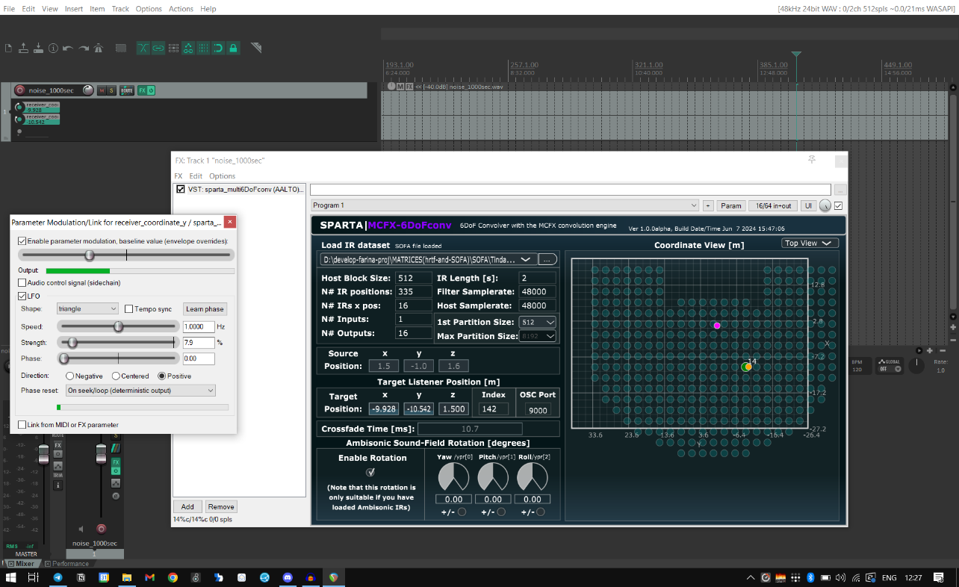
Testing & Performance Measurement

Slide 12
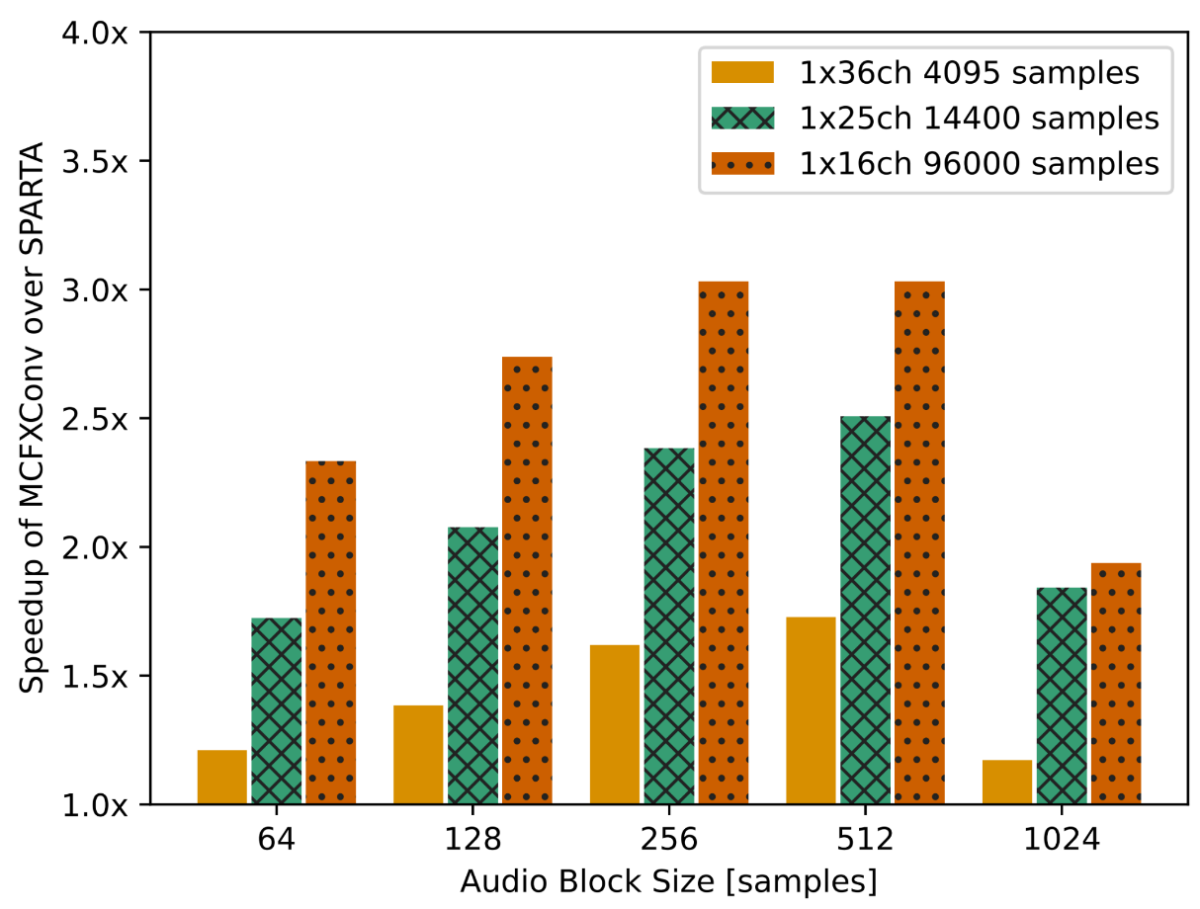
Efficient! 2 to 3x faster with 2-second IRs

Slide 13
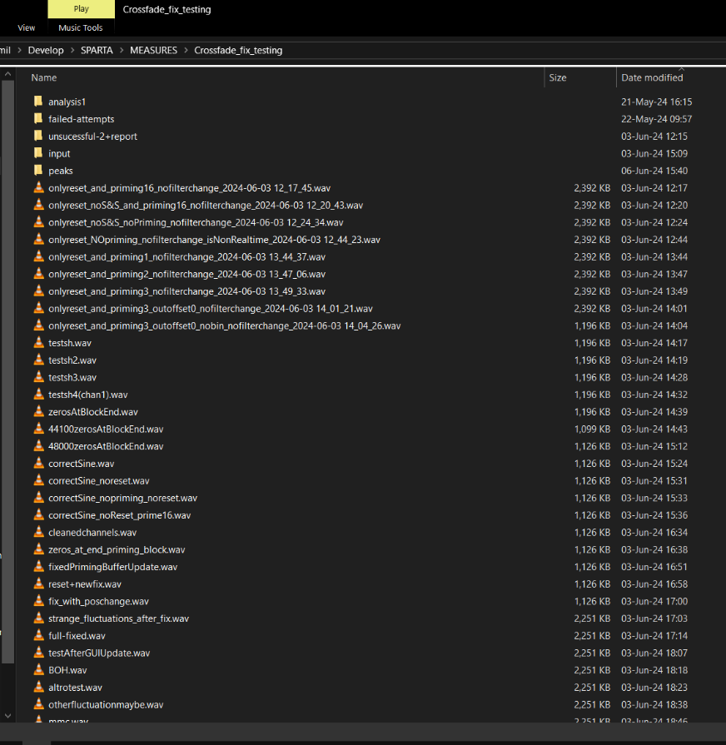
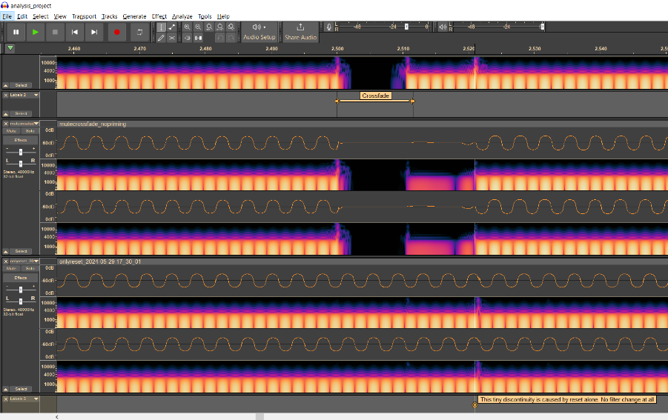
Test & Debug audio issues
Reports

Slide 14
Thank you!
domenicostefani.com

